Slide 1
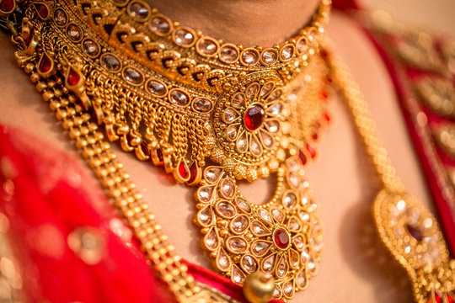
WHY SHOULD you USE DIGITAL MARKETING FOR YOUR JEWELLERY BUSINESS

Slide 2
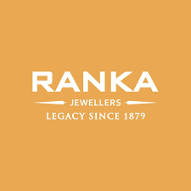

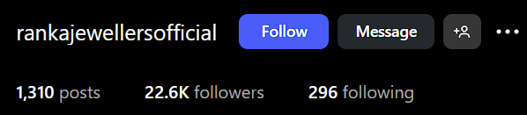
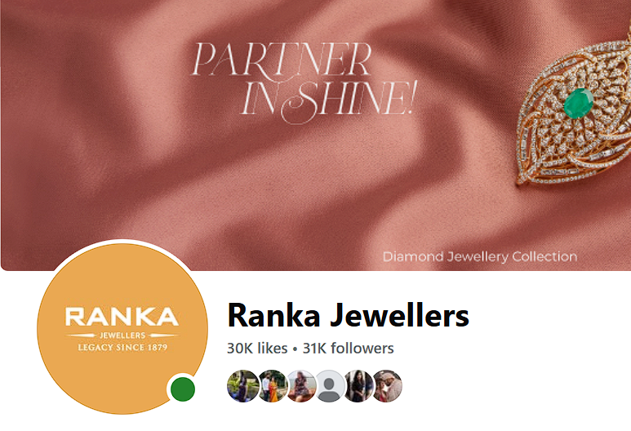
Ranka Jewellers
Social Media Presence
Instagram
Facebook

Slide 3
Stratergies used by them
1. Bold Social Media Campaigns
Krantinari” Antique Silver Collection. The reels garnered 255K+ views, boosted DMs, and drove first- time store visits—especially for this collection. Link
2. Influencer Collaborations
A Mother's Day campaign in October 2024 by Setu Advertising involved micro/nano influencers on Instagram (posts, stories, Reels). Key results:
Reach: ~966K
Impressions: ~19.8K
Engagement rate: ~1.35% (≈1.9K likes, 126 comments). Link
3. Digital Transformation at Core
Ranka’s next-gen sisters, Ishita & Aashna, have shifted the brand’s DNA online:
• Revamped e‑commerce backend, UI/UX, and expanded silver catalog achieved 68% growth in online sales, with a ~16% repeat-purchase rate. Link
•They’re actively optimizing inventory for online, preparing for international shipping around March 2024. Link

Slide 4
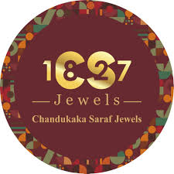

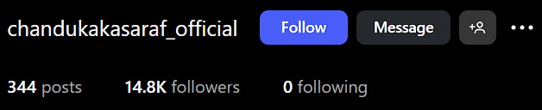
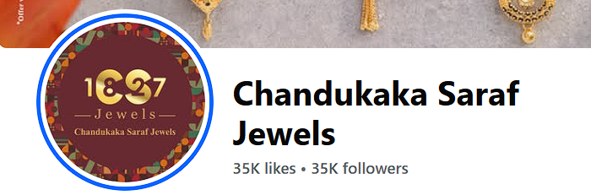
Chandu Kaka Saraf Jewels
Social Media Presence
Instagram
Facebook

Slide 5
Stratergies used by them
1. Social Media & Brand Anthem
Their newly inaugurated Charholi branch included an Instagram post featuring the opening event (with giveaways like scooters, laptops, mobiles) to generate social buzz . Link
The company mentions on its website a “strong social media presence” as part of its digital evolution .
2. E‑Commerce & Digital Transformation
Their website now supports online shopping, backed by “safe, secure, trusted” messaging, no-fee EMIs, and BIS-hallmarked product promotion. Link
3. Integrated Brand Promotions
With high-visibility events like showroom openings, ribbon-cuttings, and celebrity/influencer presence (e.g., Instagram posts), CS Jewels uses multi-channel storytelling—online (social media) complements offline events. Link

Slide 6
BENEFITS
Maximized engagement with a specific audience.
Raising customer awareness of your store and its location
Collaborate with social media influencers to promote your upcoming products and designs.
Reviews from existing customers build credibility with potential customers.
Offering special discounts and festive deals to customers.
Festivals drive the highest engagement from the target audience, making it a cost-effective strategy.
Fact Check : There are an estimated 49,500 monthly searches for 'gold jewelry’ Globally. Link

Slide 7
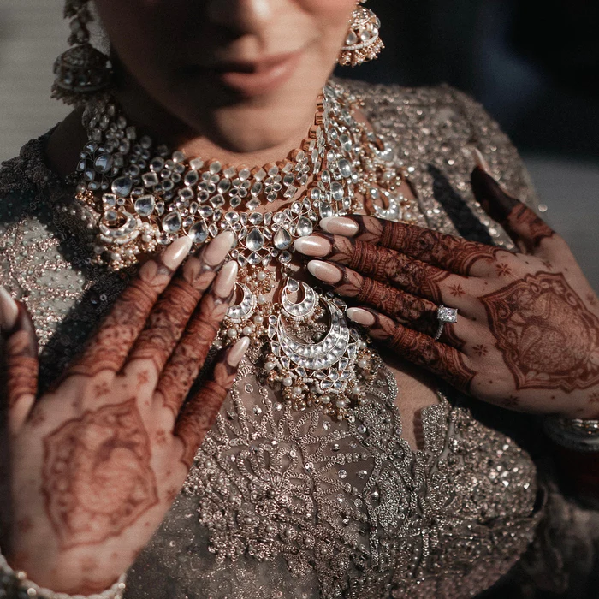
THANK YOU

